Slide 1
OPER 623 – Overviews: Heuristic Methods and Complexity
Lesson 6
Construction Heuristics… LAB!

Slide 2
Overview
TSP Nearest Neighbor Heuristic example
Nearest Neighbor runtime
Nearest Neighbor Pseudocode
Nearest Neighbor Lab assignment

Slide 3
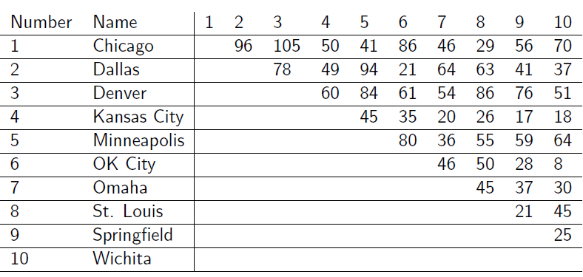
Nearest Neighbor Heuristic
Use nearest neighbor heuristic to find a tour starting in Chicago

Slide 4
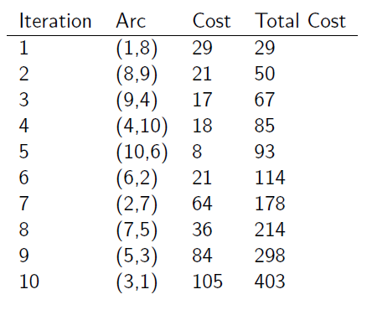
Nearest Neighbor Heuristic

Slide 5
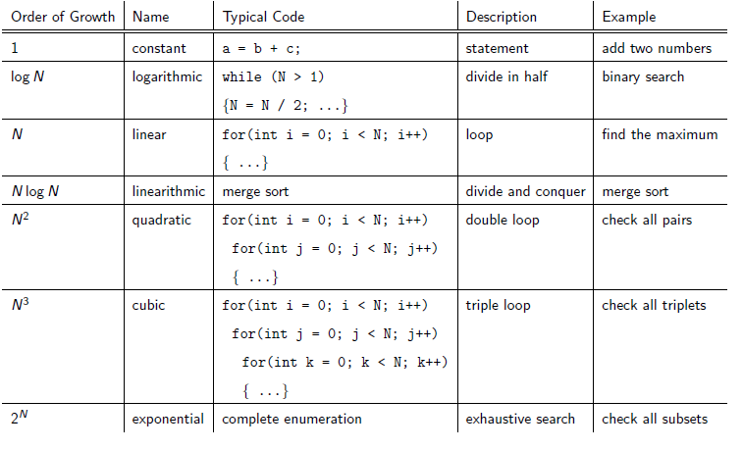
Nearest Neighbor Run-time
Recall our runtime cheat-sheet from last class
What is runtime for nearest Neighbor Heuristic?
Worst case we look at node 1’s arcs with all n other nodes Then we look at node 2s arcs with all n other nodes
We do this n times…. O(n²)

Slide 6
Nearest Neighbor Pseudocode
1: Input: n cities, matrix D ∈R^{nxn} of distances between each pair of cities
2: Initialize list tour = []
3: Initialize integer length = 0
4: Define a function valid which when given a tour outputs a list of cities which have not been visited
5: Define a function nearest which when given the current city returns the nearest city from a list
6: Define a function nearest_neighbor which when given a starting city returns a tour with tour length
7: Print out nearest neighbor tours with tour lengths for all starting cities

Slide 7
Lab Assignment
Code the Nearest Neighbor Heuristic
Solve following toy example (Data downloaded from Canvas)

